Slide 1


When Should You Use AI to Solve Problems?
We must learn to effectively integrate AI into our decision-making processes, balancing data-driven insights with human intuition. This presentation explores the opportunities and challenges of using AI to solve complex business problems.
Course Number: MSBA 300
Name: Abhay Nagarkoti
Date: 17-06-2024
Notes:
Welcome here we'll be delving into the fascinating world of artificial intelligence (AI) and its role in business decision-making.
This presentation is based on a Harvard Business Review article by Bob Suh, which explores how AI is transforming the way we approach problems.
By the end of this session, we'll have a better understanding of when to leverage AI's capabilities and when to rely on human intuition.

Slide 2

Article Reference and Summary
Suh, B. (2021, February 17). When should you use AI to solve problems? Harvard Business Review. https://hbr.org/2021/02/when-should-you-use-ai-to-solve-problems
pdf link- https://drive.google.com/file/d/1pe2xv6bxWvCDgiIvHMy7dVMUYw0VD_-A/view?usp=sharing
The Harvard Business Review article "When Should You Use AI to Solve Problems?" by Boah Suh examines the limitations of traditional intuitive decision-making and the potential for AI to transform business decisions.
Notes:
The article we're referencing today emphasizes that AI isn't a magic bullet. It's a powerful tool that, when used correctly, can significantly enhance our problem-solving abilities.
The goal is to achieve a harmonious collaboration between AI and human intelligence
The key is to strike the right balance between AI and human expertise. Suh argues that executives must adapt their traditional decision-making styles to fully harness the potential of AI. For instance, relying solely on gut feeling when launching a new product might be risky, but AI can analyze market trends and customer data to provide valuable insights.

Slide 3
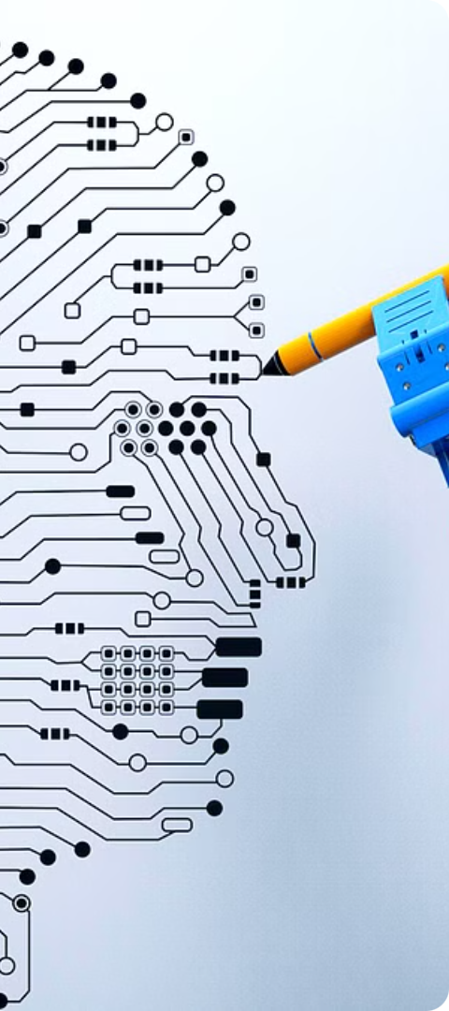
The Impact of AI on Business Decisions
1
Profound Impact
2
Rigorous Data Analysis
AI has outperformed humans in various strategic games by using probabilistic predictions and game theory, revealing the limitations of traditional intuition-based decisions.
AI can provide a level of rigor in data analysis that often lacks in traditional intuition-based decision-making.
3
Complementing Intuition
Effective collaboration between AI and human intuition is crucial for optimizing business decisions.
Notes:
AI is revolutionizing how we approach problems across various industries. In strategic games like chess, AI systems have consistently outperformed human champions through probabilistic predictions and game theory. They can analyze millions of possible moves and outcomes, identifying optimal strategies that humans might overlook. In the business world, AI is being used to analyze vast amounts of data, uncovering hidden patterns and trends. Netflix, for example, employs AI algorithms to personalize recommendations for its users. These algorithms consider a user's viewing history, ratings, and even the time of day they watch to suggest shows and movies they are likely to enjoy. This level of personalization wouldn't be possible without AI.

Slide 4
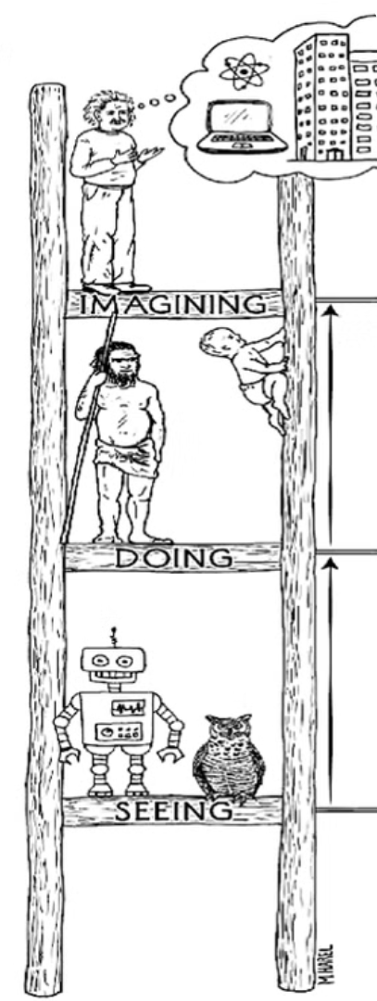
The Ladder of Causation
1
Association
AI excels at finding patterns and correlations in large datasets, but humans often misinterpret these associations.
2
Intervention
Intervention involves taking action and observing outcomes, where human creativity complements AI predictions.
3
Counterfactuals
Counterfactual thinking, an area where human intuition is crucial, provides insights that purely data-driven approaches might miss.
Notes:
To better understand how AI fits into decision-making, we'll use Judea Pearl's Ladder of Causation. This framework categorizes different levels of inferential thinking (Inferential understanding means that the reader must “read between the lines” which can lead them to think beyond the text and reflect on their thinking).
Association: The most basic level is association, which involves identifying relationships between variables. For example, a retailer might notice that customers who buy bread often buy milk as well.
Intervention: The next level, intervention, involves taking action and measuring the impact. A company might run a marketing campaign and then analyze its effect on sales.
Counterfactuals: The highest level, counterfactuals, involves imagining "what if" scenarios to understand cause and effect. For example, a company might ask, "What if we had launched this product a month earlier?"

Slide 5
AI Excels at Association
Predictive Power
Limitations
Example
AI can identify patterns and correlations in large datasets, enabling accurate predictions of user behavior and engagement.
Humans often misinterpret correlations, leading to flawed decisions. AI-powered association alone is not enough for effective decision-making.
Social networks use AI to predict user engagement and optimize content delivery, complementing human intuition.
Notes:
AI is exceptionally good at the association level of the ladder. It can rapidly analyze large datasets to identify correlations and patterns that humans might miss. For example, Social media platforms are a prime example of how AI leverages associations to keep users engaged. By analyzing a user's likes, shares, and browsing history, AI algorithms can recommend content that is likely to pique their interest. This can be anything from news articles and funny videos to friend suggestions and product recommendations. For instance, if you frequently watch cat videos on YouTube, the platform's AI will suggest similar content, creating a personalized echo chamber. In the retail industry, AI can analyze past purchases and browsing behavior to identify products that are frequently purchased together. This allows retailers to recommend complementary items to customers, potentially increasing their basket size and overall sales. However, it's important to remember that correlation doesn't equal causation. Just because two events happen together doesn't necessarily mean one causes the other. A classic example is the correlation between ice cream sales and shark attacks. While both may increase during the summer months, there is no causal relationship between the two.

Slide 6




The Importance of Intervention
Hypothesis
Intervention involves testing market scenarios and observing the outcomes, validating AI predictions.
Experimentation
Experimental approaches are crucial to ensure AI-driven decisions are grounded in real-world evidence.
Validation
Combining AI predictions with human creativity can provide valuable insights for optimizing business strategies.
Notes:
Intervention involves taking action based on the insights gained from association. While AI can offer valuable predictions, human creativity is essential for designing and implementing effective interventions. For example, a pharmaceutical company might use AI to predict which drug compounds are most likely to be effective against a certain disease. However, it takes human scientists to design and execute clinical trials to test these predictions and determine if the drug is safe and effective for human use. Another example is in marketing, where AI can identify the most promising target audience for a campaign, but human marketers are needed to craft compelling messages and creative strategies

Slide 7
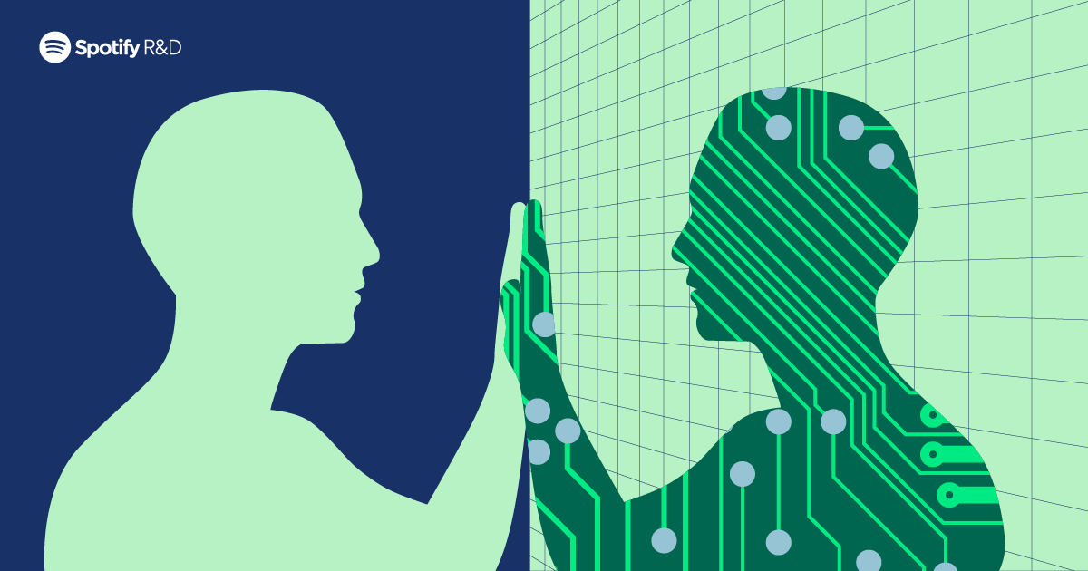
The Role of Counterfactuals
Imagining Alternatives
Complementing AI
Counterfactual thinking involves considering different scenarios and outcomes, an area where human intuition and creativity are crucial.
Counterfactuals can provide insights that purely data-driven approaches might miss, enhancing the decision-making process.
Example: Product Innovation
McDonald's used counterfactual analysis to inform their product innovation strategy, combining AI predictions with human intuition.
Notes:
Counterfactual thinking involves imagining alternative scenarios and considering "what if" questions. This is where human intuition plays a critical role. We can envision possibilities that AI might not consider, leading to innovative solutions and breakthroughs. In the business world, counterfactual analysis can be used to evaluate the potential impact of different decisions or to assess the effectiveness of past strategies. For instance, McDonald's used counterfactual thinking to understand the impact of their R&D on new products. They asked, "What if we hadn't invested in research? Would we have the McFlurry?". Another example, a company considering a new product launch can use counterfactuals to explore different scenarios. They might ask questions like: "What if we target a different market segment with this product?" or "What if we adjust the pricing strategy?" By simulating these different realities, the company can gain valuable insights into the potential risks and rewards associated with each option, ultimately making more informed decisions.

Slide 8



The Power of Human-AI Collaboration
Data Processing
Human Intuition
Synergistic Approach
AI's strength in data processing and pattern recognition.
The importance of human creativity and contextual understanding.
Combining AI's strengths with human expertise to solve complex problems.
Notes:
The most effective decision-making often involves a collaboration between humans and machines. This is where we leverage the strengths of both AI and human intelligence. AI excels at processing vast amounts of data, recognizing patterns, and making predictions based on that data. Humans, on the other hand, are skilled at understanding context, asking the right questions, and applying creative thinking to complex problems.
The search for Air France Flight 447 is a classic example of this synergy. When the plane tragically crashed in the Atlantic Ocean, AI algorithms were used to narrow down the search area based on ocean currents and debris patterns. However, it was ultimately human expertise and intuition that led to the discovery of the wreckage. The combination of AI's data-driven insights and human judgment proved invaluable in solving this complex real-world problem.

Slide 9
Key Takeaways
Balance AI and Intuition
Effective decision-making requires a synergy between AI's data processing and human intuition.
Identify the Right Problems
Executives must learn to recognize which problems are best suited for AI and which require human creativity.
Self-Disrupt Decision-Making
The integration of AI into business decisions necessitates a shift in traditional decision-making styles.
Notes:
To wrap up, let's revisit the key takeaways from on AI and decision-making.
Balance Between AI and Human Intuition: Effective decision-making isn't about choosing one over the other. It's about finding the sweet spot where AI's ability to process vast datasets and detect patterns complements human intuition's capacity for context and creativity. This balance ensures comprehensive problem-solving, leveraging the strengths of both.
Identify the Right Problems: Not all problems are created equal. Some are tailor-made for AI's analytical power, like predicting customer churn or optimizing supply chains. Others demand nuanced human judgment, such as ethical dilemmas or creative problem-solving. Executives who can discern which problems benefit most from AI versus human intuition will optimize their resource allocation and decision-making effectiveness.
Self-Disrupt Decision-Making: Embracing AI isn't just about adopting new technology; it's about challenging the status quo. To truly leverage AI's potential, we need to disrupt our traditional decision-making norms and foster a culture that's receptive to innovation and data-driven insights. This self-disruption is essential for staying competitive in today's rapidly evolving business landscape.
Remember, AI is a tool that we can use to augment our abilities, not replace them. By working together with AI, we can unlock new levels of problem-solving and decision-making, ultimately leading to better outcomes for our organizations and society as a whole.

